Slide 1
What the Federal Budget Process Does to Higher Ed
Jason Delisle
Director, Federal Education Budget Project New America Foundation
Delisle@newamerica.org

Slide 3
Sources: New America Foundation, White House Office of Management and Budget

Slide 4
What is the Pell Grant funding cliff?

Slide 5
$104.9 billion
March 2011 CBO Baseline [After CR]
Sources: New America Foundation, Congressional Budget Office

Slide 6
$77.5 billion
March 2011 CBO Baseline [Jan. 2012]
Sources: New America Foundation, Congressional Budget Office

Slide 7
$68.7 billion
March 2012 CBO Baseline
Sources: New America Foundation, Congressional Budget Office

Slide 8
$47.5 billion
Aug 2013 CBO Baseline

Slide 9
April 2014 CBO Baseline
Sources: New America Foundation, Congressional Budget Office

Slide 10
Federal Student Loans Interest Rates, Refinancing, and “Profits”

Slide 11
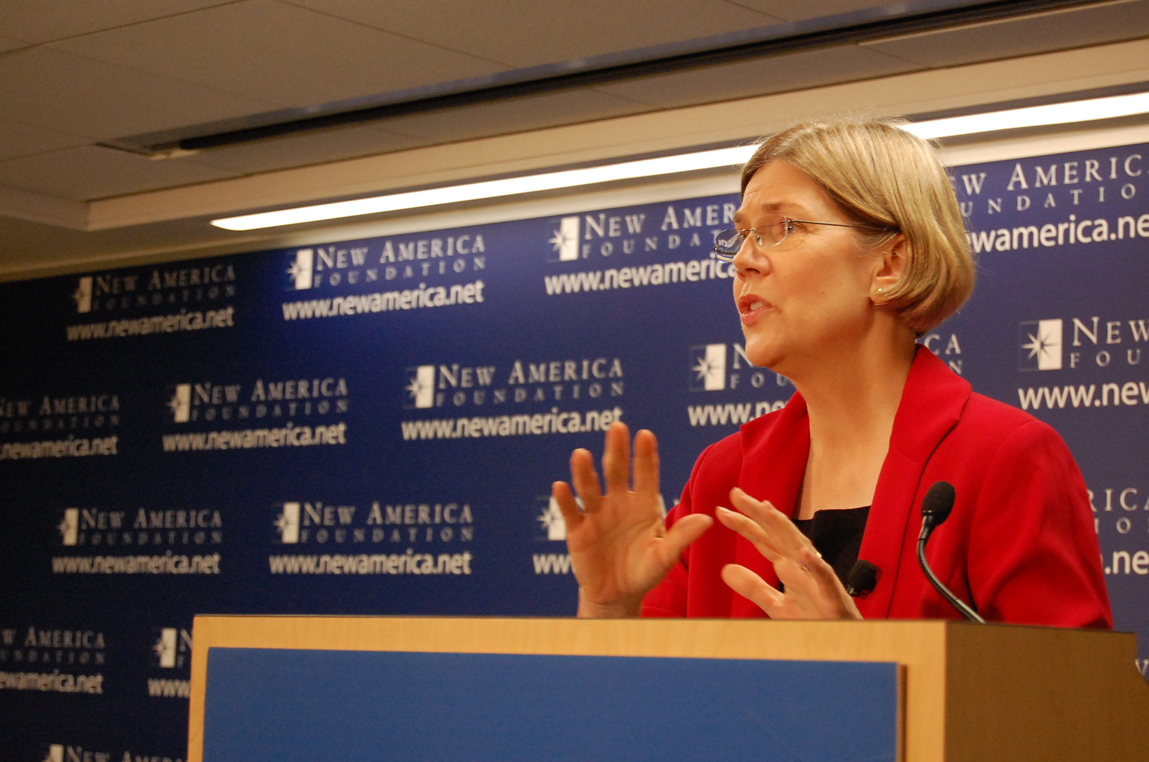
Sen. Elizabeth Warren (D-MA)
Photo licensed Creative Commons by Flickr user New America Foundation

Slide 12
Tax Benefits for Higher Ed Do Those Cost Money?

Slide 14
Jason Delisle Director, Federal Education Budget Project New America Delisle@newamerica.org 202-596-3379

